Slide 1
The demise of Google+
An Ethics Case study
For
ENCP 6000 Sec 02
Group 5
Haonan Quan
Menghui Wang
Tian Wang
Zixiao Wang
Pranav Mujumdar
Notes:
Hello everyone this is group 5, our topic is the demise of Google+

Slide 2
Background
Google launched its social network named Google+. It aimed at FACEBOOK’s weakness and people’s desire. But it didn’t do a good job.
At that time:
Google has tried a bunch of social networks before and failed almost all of them.[1]
FACEBOOK had a privacy scandal
Besides FACEBOOK, other places and enterprises had some scandals and crises too
In the end, google failed and shut down its Google Plus
Notes:
google plus has no ads, you can choose people who could see your post, easy to manage privacy.
more private
1.(Orkut, blogger, google talks,Google Buzz and now Google plus)
2. Sony PlayStation was hacked, Egypt shut off its internet in order to crack down demonstrators(people fear that FACEBOOK would do the same to them). SV also has a racism problem.

Slide 3
Main issue
The company should focus on its software security.
Google didn’t provide a unique social network[2]
Did not respect the consumers’ intentions
Didn’t inform consumers about privacy leaks until it was reported by The Wall Street Journal.[3]
Notes:
bullet 1: While data was exposed, there is no evidence that it was improperly accessed
bullet 2: google copied a lot from facebook yet left event which people love
bullet 3: google force people to follow real policy and if they don’t do that they will be baned and they force people to have a plus account if they need to use other google servicce

Slide 4
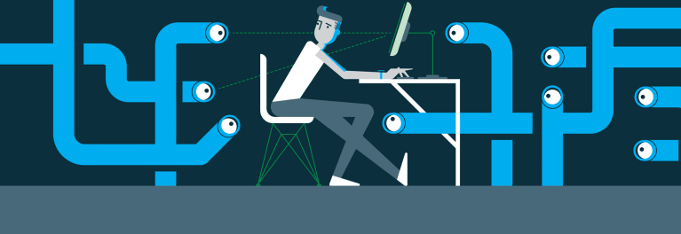
What is interesting about this case
Google+ asked for users’ information but it didn’t protect them.
If privacy can be used for proper conduct (Police handling cases for example), can it be disclosed?
Notes:
What about interesting things?
The first one is Google uses their user’s information but it didn’t protect them. It was like a company didn’t protect the things where they make a profit from.
Another thing and it’s an interesting open-ending question is. If privacy can be used for some proper conduct, can it be disclosed?

Slide 5
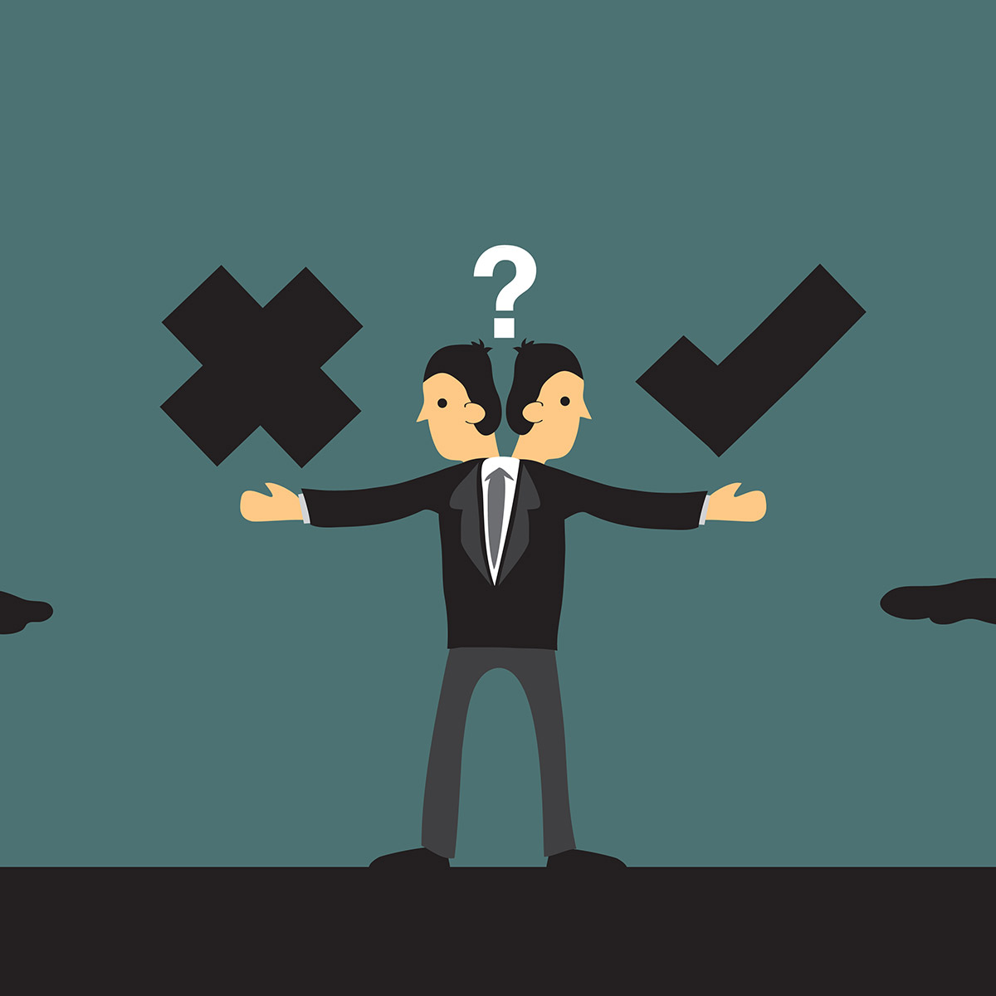
Ethical significance
Ethics is a branch of philosophy that involves systematizing, defending, and recommending concepts of right and wrong conduct.
Business ethical issues reflect the interaction of profit-maximizing behavior with non-economic concerns.
NSPE(National Society of Professional Engineer) Fundamental Canons[6] :
Hold paramount the safety, health and welfare of the public
Perform services only in areas of their competence
Avoid deceptive acts.
Notes:
Next, I will introduce ethical significance.
For most people, following ethics will help you not offend others unconsciously in most scenarios
For companies, ethics will give a reference to balance profit-making behavior with non-economic concerns

Slide 6

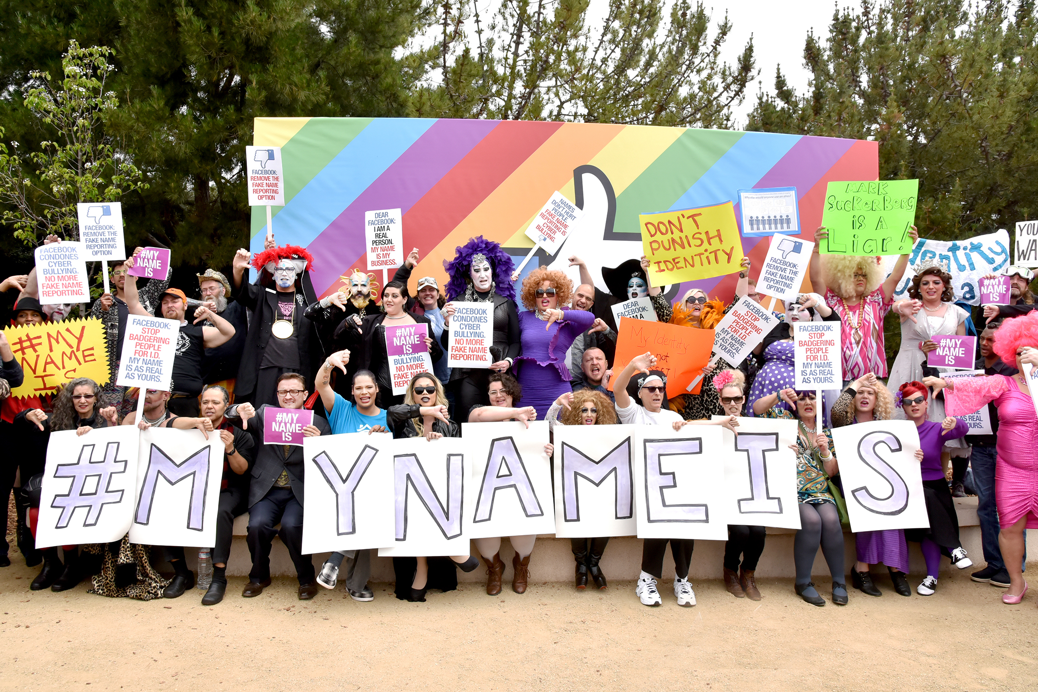
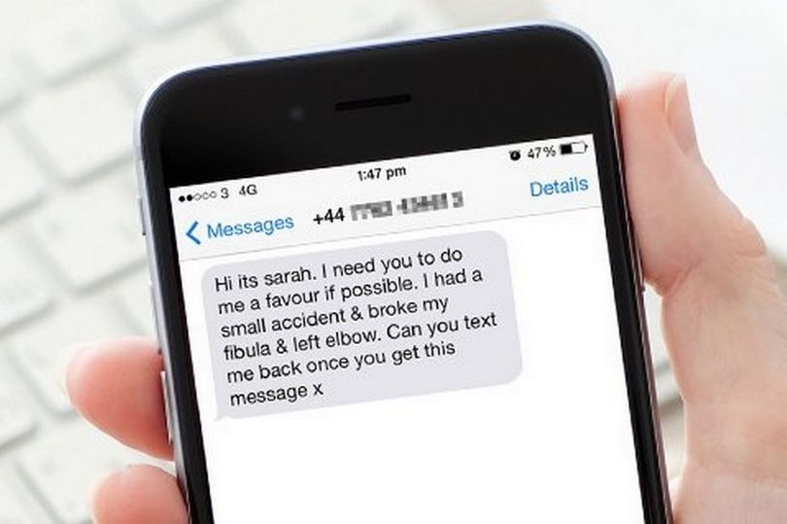
Impact
All-or-nothing plan
affected users‘ experience on other products.
Ironically, Google+ aimed at making life better while it actually troubled users[4]
Real name policy
made anonymous speech impossible on any of the product of Google[5]
Information exposure
created a potential danger for each user. It could be fatal if a fraud company and criminals get those personal information
Notes:
The policies Google + took did rock the boat and upset the users
1. The all or nothing plan Forced public link other accounts
Which Made it troublesome for users to login. Google+ just made things more complicated as we could see from this picture.
2. Real name policy Let users would be identity by others, made anonymous speech impossible on any of the product of Google.
a group of protestors gathered protest this policy.
3. If real name policy bothered part of users, then Information disclosure created potential danger for each user. It would be a disaster if fraud organizations or criminals got those information.

Slide 7
Consequences
•1. Closed Google+ and suffered the actual loss
• users, money
•2. Squandered a beautiful opportunity

Slide 8
Conclusion and Was this preventable?
Violated Ethical Rules of Practice[6] and Professional Obligations
Deceitful practice of banning people from other google products
Didn’t serve the public interest
Was this preventable?
It certainly was!
They did admit their mistake
Ended up shutting the product down altogether
a little too late!
Bad decisions and ethical malpractices eventually lead to failure of business!
Notes:
So according to the Code of Ethics for engineers by NSPE, in this case we found that there are few violations on part of google, they deceived the users by banning them from ALL the google products, under the real names policy, And Code of Ethics tells us to Avoid Deceitful acts. Also as engineers we should serve the public interest, we should use technology to make their lives easier, google ended up completely missing on this, coz people wanted something better than facebook. The security loophole in the apis didn’t help their case either.
They Admitted their mistake honestly and publicly, after the wall street journal reported it, they firstly should’ve been more careful about the data breach, and should’ve disclosed it themselves, which consequently made people lose their trust in the product
Was this all preventable, yes it certainly WAS! had they worked ethically and created something that people really wanted “a good social media platform that wasn’t evil like facebook”, google plus might have been a hit
All these bad decisions and ethical malpractices didn’t really fall into their favour as nobody used google plus, and they had to shut down the product!

Slide 9

Thank you and Goodbye Google +

Slide 10
References in APA format
[1]. A Look Back at Google’s History of Social Media Failures. Garett Sloane July 1, 2014
[2]. Why Google's social network was a spectacular failure. JP Mangalindan October 9, 2018
[3]. Google is shutting down Google+ following massive data exposure. Swapna Krishna October 8, 2018
[4]. Google+, YouTube Comment Integration Sparks User Outrage. Stephanie Mlot November 11, 2013
[5]. Who is harmed by a "Real Names" policy? Geek Feminism Wiki
[6]. “Code of Ethics for Engineers” by National Society of Professional Engineers. Publication Date as revised, July 2019 • Publication #1102

